Slide 1
Introduction to your Device
Ms Sastre: Computer Class

Slide 2
What we will learn today:
Tips for your device
How to access all your Apps with Office 365
Organising your websites and applications
Accessing the Teams Channel for this class.

Slide 3

Tips for your device
Keep your device charged up!
Keep your device muted during classes.
Keep your schoolwork neat and tidy.

Slide 4
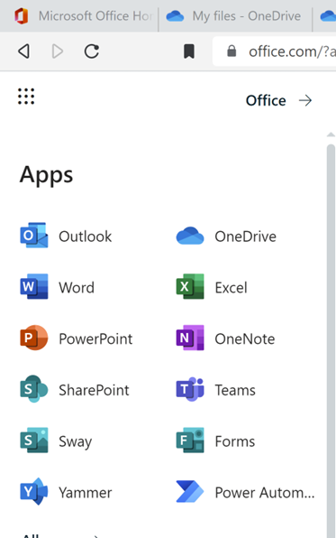
How to access Office 365
Go to Office.com
Browser VS Installed Apps
Go-to for all your school applications including OneDrive and Teams.

Slide 5
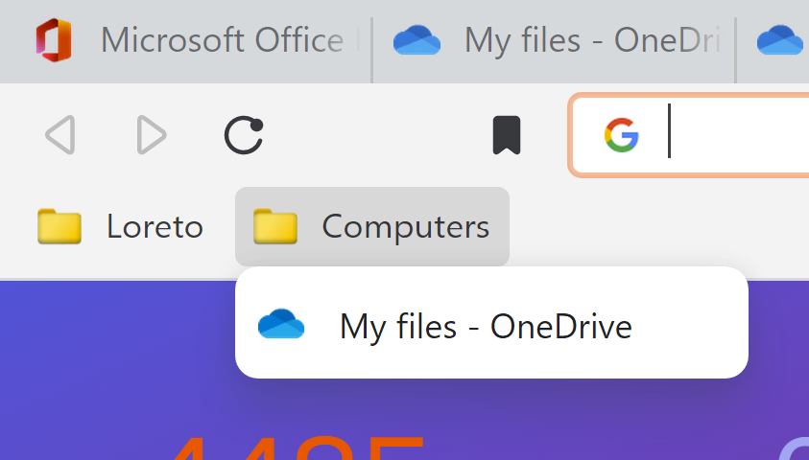
Organising Websites and Applications
For Websites we use Bookmarks
For Applications we Pin to taskbar.
Makes life easier and finding what we need faster.

Slide 6
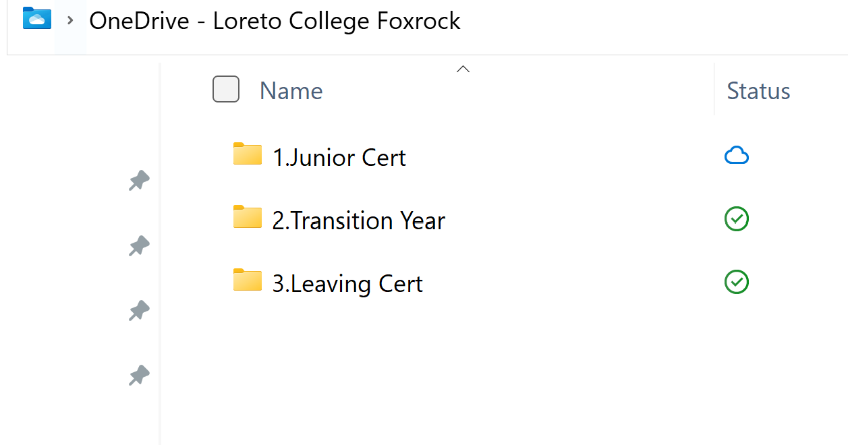
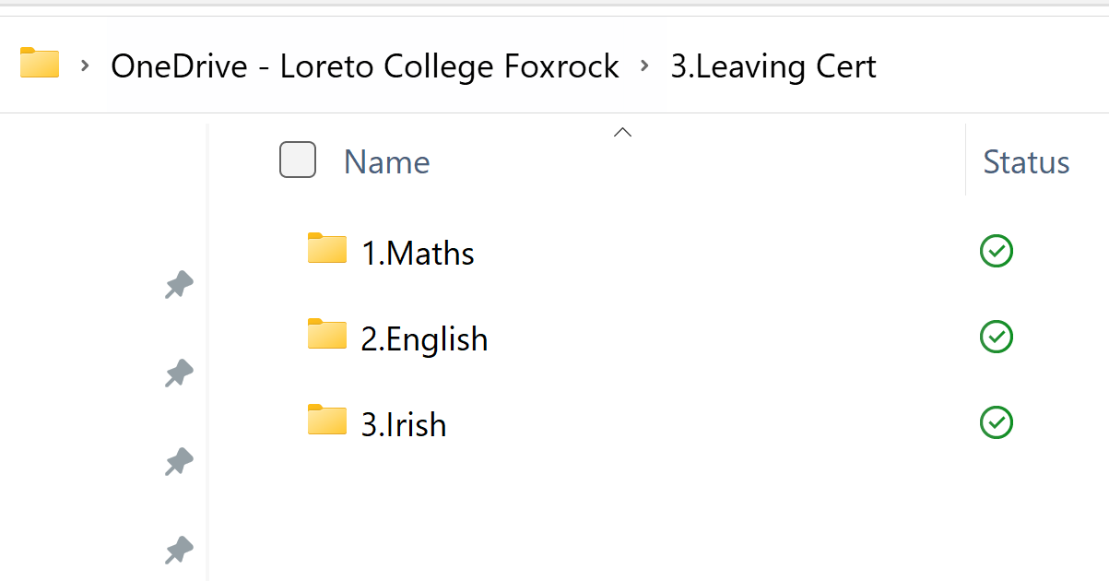
Organising your folders on OneDrive
This is what I expect to see.
Split up into years.
Then split up into subjects.
Start with a number and capitol letter.

Slide 7
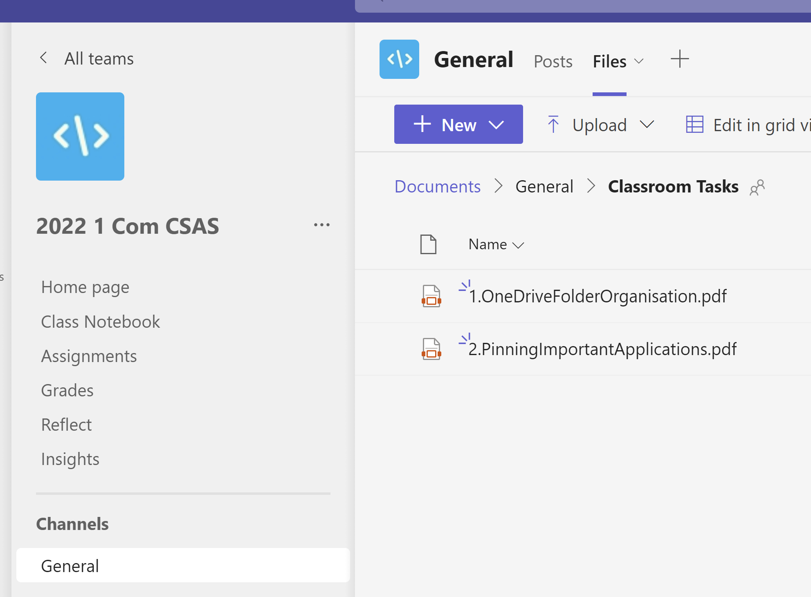
Teams Channel
Work in pairs today.
Access Teams channel with the Code: 31eqtc3
Go to Files -> Classroom Tasks
Start 1.OneDriveFolderOrganisation

